Slide 1

Business Model

Slide 2
Executive Summary
Milkman is an ordering solution which empowers vendors with the ability to safely continue selling their goods through delivery and scheduled collection without the need of customer footfall.

Slide 3
Problem Analysis
A huge amount of vendors still do not sell their goods online. During the Corona Crisis, not having digitized sales turned out critical for SME retailers: no or few sales through unsuitable channels like WhatsApp or SocialMedia.
These stationary shops address local consumers or bypassing customers. Due to the lockdown, customers could not visit the stores anymore. Uncertainty when the situation will be over remains.
The trend and demand towards online shopping and real time delivery keeps growing, on both consumer and business side.

Slide 4
Problem Analysis
Lockdown Restrictions imposed due to the Covid-19 outbreak has forced the closure of many small vendors.
Many of which have no digital presence and have taken to social media to find an alternative means to advertise and sell their goods, incurring a lot of additional logistic work to figure out the best way to reconnect with their customers.

Slide 5
Solution
Providing an App for all type of local vendors that enables them to digitize their sales and compete at the online market.
Channeling the orders from multiple platforms (Instagram, WhatsApp, Facebook, Marketplaces, etc.) to only one platform.
Allowing consumers to one-stop-shop their favorite local shops online, while collecting or receiving goods even faster than in traditional online shops.

Slide 6
Targets / Objectives
Provide SMEs with a useful tool that allows them to keep their business running as much as possible and with it, avoid job losses, business closings and an economic recession in the countries.

Slide 7
Unique Selling Proposition
One-stop-shop for all types of local stores
Collection or direct delivery option (microshipping)
Allowing vendors to employ their own drivers
High level of transparency about orders and deliveries (Order status, Ready for pick-up, Driver status/location)
Enabling business governance through built-in accounting functions

Slide 8
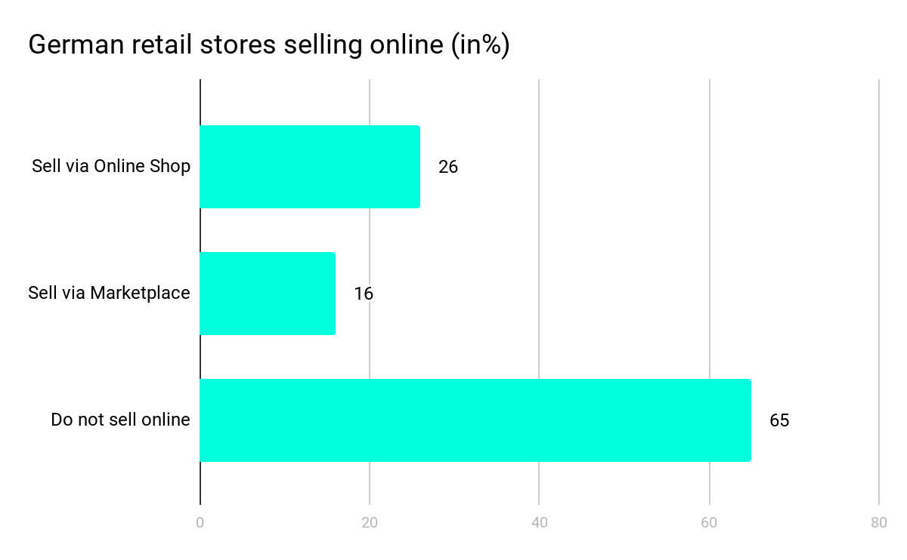
Market Analysis
Retail SMEs contribute with a turnover of 5.5 trillion € significantly to Europe’s economy . Yet, in Germany only 65% of all retailers sell online and only 16% use Marketplaces like Amazon or eBay.
The amount of vendors searching to digitize their business during and after the Corona crisis is expected to increase significantly.

Slide 9
Market Analysis
Two third of people working in Retail are employed in a SME (11.3 million employees in Europe) and many had to rely on governmental help during the lockdown or got unemployed.
It is estimated that there is a loss of retail sales of 3,730 million € during the lockdowns caused by Covid-19. This results in an additional lack of 783.3 million € in VAT for the European states.
Also many states had to provide various funds and packages to support businesses and employees during the crisis.

Slide 10
Market Forecast
Based on the general, continous growth of digitalisation, especially in the Retail sector, the market is expected to keep growing.
In fact, the Covid-19 Crisis could possibly even push this development even further, as many retailers without online sales or digital business opportunities are now facing the disadvantages of purely brick & mortar built stores.
Big players like Amazon, are also trying to make efforts towards connecting local stores, which only speaks for the growing demand of such solutions.

Slide 11
Competitor Analysis
Facebook - several local buy-and-sell groups, but they work through postings only (no click and buy).
Vendito - start-up in Mexico
eBay - 50 free product listings per month, 35 cents per listing beyond. 10% final value fee for every sell. No click & collect support
Glovo

Slide 12
Competitor Analysis
Amazon - best for selling larger quantities of products. It costs $39.99 per month and if you sell more than 40 items per month, the fee is 99 cents per sale plus additional referral and variable closing fees. Anyhow, the service does not support click & collect.
Amazon Local - recently launched in India in order to include and connect local stores. Does not offer Click&Collect.

Slide 13
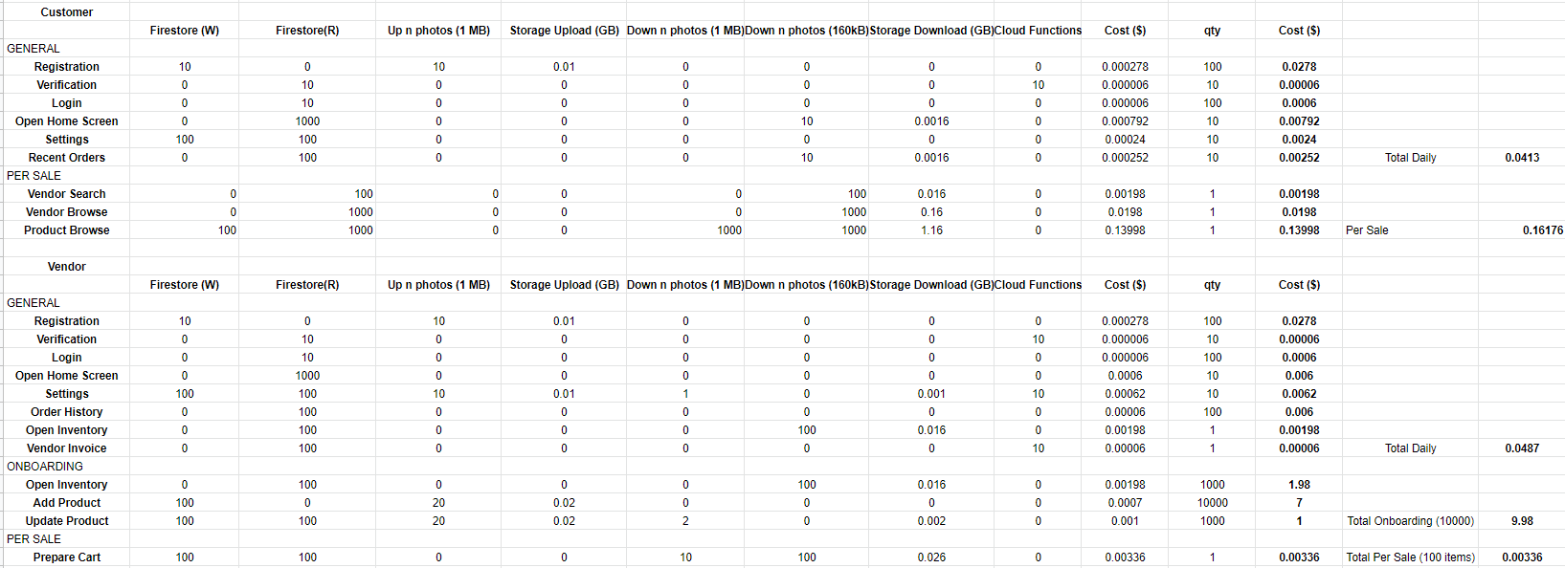
Financials
Costs per transaction are expected to be less than 1€ in any case:

Slide 14
Revenue Models
Transaction cost fee based Revenue Model, paid by the seller. This gives us a Profit Margin of:

Slide 15
Notes/thoughts/Scribbles
In the global business environments, small and medium sized companies (SMEs) are increasingly using information and communications technologies (ICT) based electronic commerce (EC) to obtain a competitive advantage within the market and have access to more global markets.
Despite the exponential growth of the EC among SMEs, the adoption rate of the EC by these companies has remained relatively low. Large companies have benefited more than SMEs in both their improved sales and cost savings.
SMEs generally have limited access to market information and in consequence, they suffer globalization constraint.
SME's rarely use management techniques such as financial analysis, forecasts and project management.
They tend to employ generalists rather than specialists, rely on short-term planning, informal and dynamic strategies, they lack of a decision-making process, and standardization of operating procedures are other distinctive features of SMEs.
Restricted resources controlled by SMEs, is the main differentiator between SMEs and large organizations. (Ghobakhloo M. et al., 2011)
Reference
Ghobakhloo, M., Arias-Aranda, D. & Benitez-Amado, J. 2011, "Adoption of e-commerce applications in SMEs", Industrial Management & Data Systems, vol. 111, no. 8, pp. 1238-1269.

